Slide 1
APOLOGETICS
IN ONE LESSON
almost
Ai1L.net
Introduction

Slide 2
1
Jesus was crucified

Slide 3
2
Jesus’ disciples had real experiences of the resurrected Jesus

Slide 4
3
The disciples were transformed & were willing to die for their message

Slide 5
4
James (Jesus’ brother) had a real experience that he thought was an appearance of Jesus

Slide 6
5
Paul also had a similar appearance of Jesus and converted

Slide 7
6
The Gospel was proclaimed within 1-2 years from the crucifixion

Slide 8
✓
1
Jesus was crucified
✓
2
Jesus’ disciples had real experiences of the resurrected Jesus
✓
3
The disciples were transformed & were willing to die for their message
✓
4
James (Jesus’ brother) had a real experience that he thought he had an appearance of Jesus
✓
5
Paul also had a similar appearance of Jesus and converted
✓
6
The Gospel was proclaimed within 1-2 years from the crucifixion

Slide 9
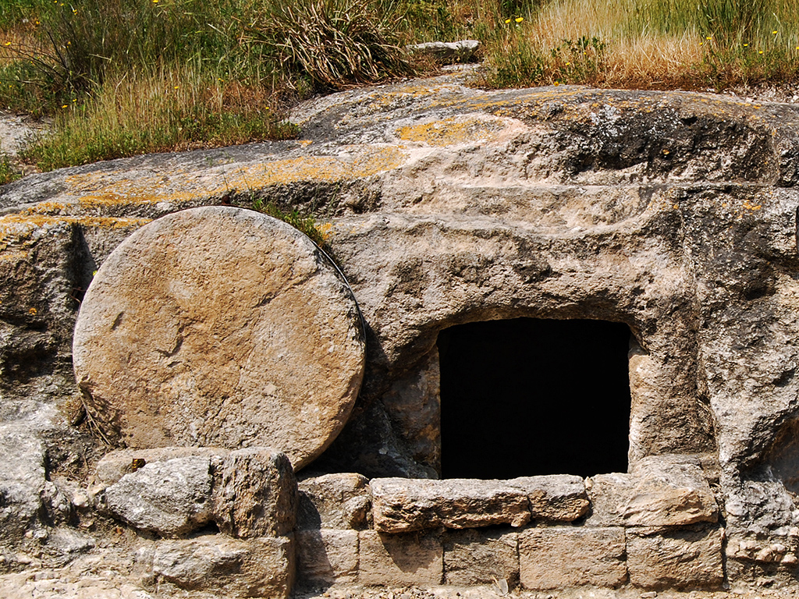
Tomb in Jezreel Valley
Photo by Ferrell Jenkins

Slide 10
Main facts
1
Jesus was resurrected
2
The New Testament came from eyewitnesses

Slide 11
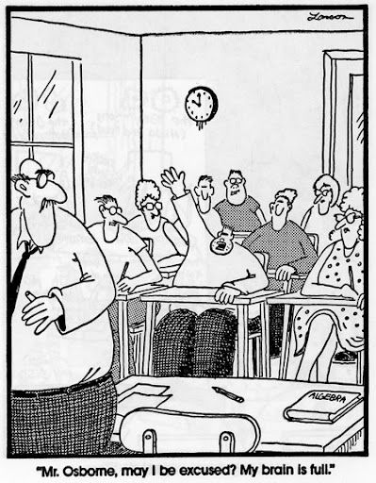

Slide 12
Why focus on a defense of the resurrection?
1
It’s Biblical
2
It’s simpler & easier (since the Gospel is your strength)
3
Become more knowledgeable about the Gospel accounts

Slide 13
Values & Needs
“I want Christianity to be true”
Facts “I believe Christianity is true”
Christianity can explain values
(why racism is wrong, why truth matters, etc.)
Undesigned coincidences
Eyewitness sources
Christianity can fill our deepest needs (hope, love, forgiveness, justice)
Christianity shouldn’t exist (if not for Jesus’ resurrection)
Ancient Jewish teaching practices
Prophecy (Isaiah 53)

Slide 14
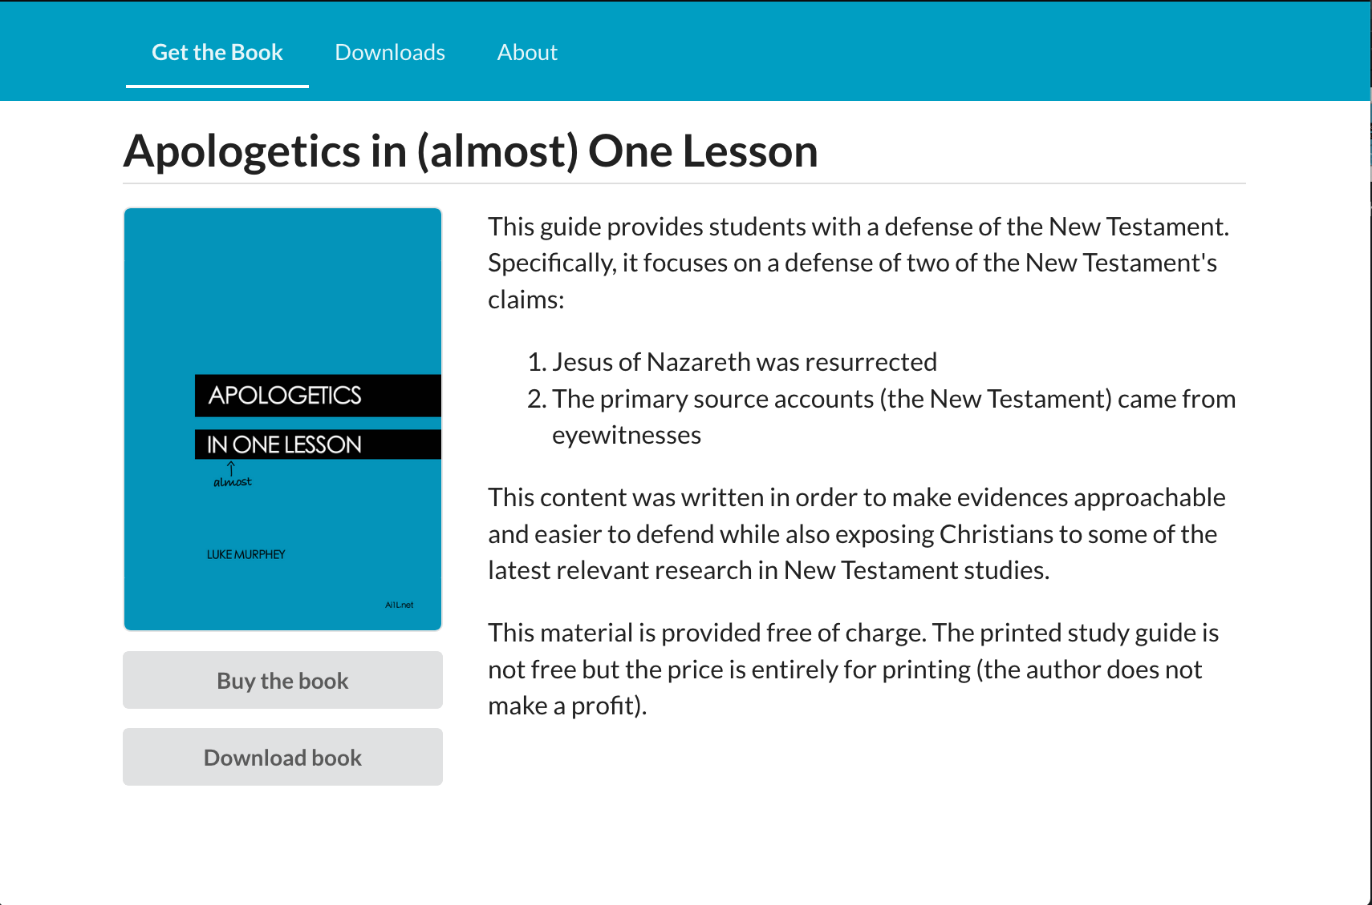
https://Ai1L.net

Slide 15
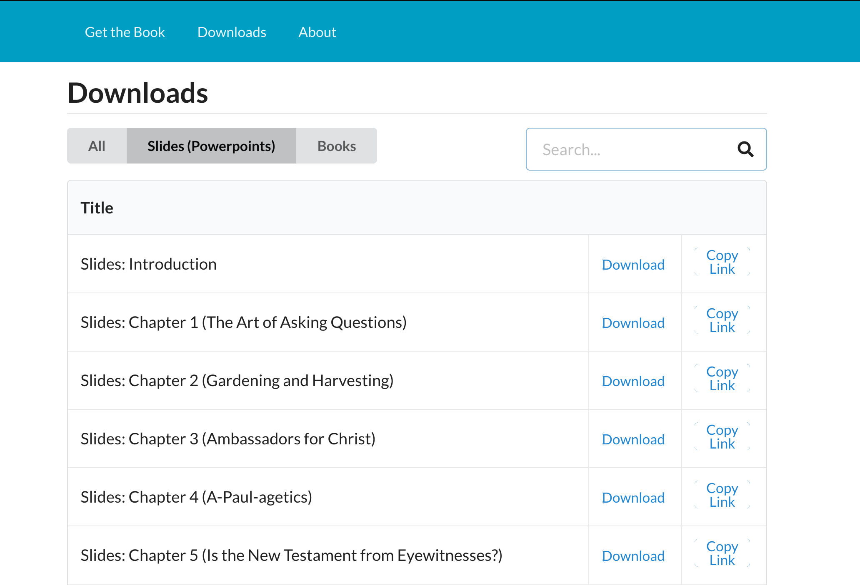

Slide 16
Date | Day | Lesson
10/4 | Sun | Introduction
10/7 | Wed | 1. The Art of Asking Questions
10/11 | Sun | 2. Gardening and Harvesting
10/14 | Wed | 3. Ambassadors for Christ
10/18 | Sun | 4. A-Paul-agetics
10/21 | Wed | 5. Is the New Testament from Eyewitnesses?
10/25 | Sun | 6. Eyewitness Memory
10/28 | Wed | 8. Jesus the Rabbi (Ancient Teaching Methods)
11/1 | Sun | 9. How Not to Start a Religion
11/4 | Wed | 10. “Christians believe by ‘faith’, not facts”
11/8 | Sun | 11. Evidence for God that Everyone Has (Romans 1:18-23)
11/11 | Wed | 12. Undesigned Coincidences in the Gospels
11/15 | Sun | 13. Undesigned Coincidences in Paul’s Letters and Acts
11/18 | Wed | 16. With the Gospel, I See the World as It Is
11/22 | Sun | 21. Regarding Miracles
11/25 | Wed | 20. “Jesus didn't claim to be God”
11/29 | Sun | 15. “You cannot trust the Gospel authors since they were Christians”
12/2 | Wed | 17. The Gospel According to God (Isaiah 53)
12/6 | Sun | (continue)
12/9 | Wed | 19. Out of Context I Called My Prophecy?
12/13 | Sun | 24. Facts 1 & 2: Jesus Died by Crucifixion and His Disciples Believed He Resurrected
12/16 | Wed | 25. Facts 3 & 4: Early Skeptics (Paul and James) Became Believers; the Tomb was Empty
12/20 | Sun | 27. Dealing with Doubt
12/23 | Wed | 14. “The Bible is full of contradictions”
12/27 | Sun | 22. “The copies of the New Testament have been corrupted beyond recovery”
12/30 | Wed | Review

Slide 17
 | Lesson
7. | The Primacy of the Primary Sources
18. | “Isaiah 53 is not a good example of fulfilled prophecy”
23. | Has the Bible Been Mistranslated?
26. | Response to the Minimal Facts for the Resurrection
28. | Why Doesn’t God Make Himself More Obvious?

Slide 19
Four facts support Jesus’ resurrection
1
Jesus was crucified
2
Jesus’ disciples believed he resurrected
3
Early skeptics (Paul, James) became believers
4
The tomb was empty

Slide 20
Key Takeaways
1
The approach we use is important; probably more than the arguments we use
2
Belief in Jesus is based upon one fact in history: Jesus’ resurrection
3
The resurrection can be supported by four facts: 1. Jesus was crucified
2. Jesus’ disciples believed he resurrected
3. Early skeptics (Paul, James) became believers
4. The tomb was empty

Slide 21
Lesson | Goal
1. The Art of Asking Questions | Make discussing our convictions easier (set the bar low)
2. Gardening and Harvesting | Focus on making progress, don’t get excessively worried about results
3. Ambassadors for Christ | Our approach matters more than the arguments we use
4. A-Paul-agetics | Use cultural ideas to promote the Gospel

